Slide 1
CS 2600 Computer Networks I Dr. Sayeed Sajal Chapter 2: Getting Connected Lecture 7

Slide 2
Comparing the Two Models

Slide 3
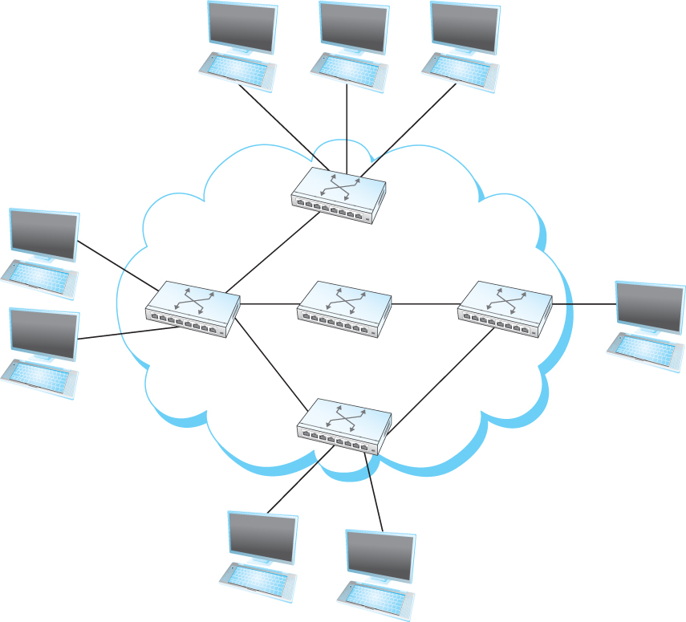
Figure 1.3 Switched Network (Review)
OSI Layer 3
OSI Layer 2
OSI Layer 2
OSI Layer 2
internal nodes (switches)
OSI Layer 3
external nodes (hosts)

Slide 4
The Realms of Switching and Routing

Slide 5
Where Switching and Routing Are Defined
Switching standards are defined in the 7-layer OSI model (layers 1-3)
These generally describe how a message travels across a single network
In the 4-layer Internet model, this fits into layer 1
Examples: Ethernet, Wi-Fi, ATM
Internetworking standards for routing between networks are defined in layer 2 of the Internet model , by the Internet Protocol (“IP”)*
These describe how a packet flows from one network to another (over the Internet, for example)
*To be fair, some internetworking standards called CLNP and CLNS were added to layer 3 of the OSI model later on, but they aren’t used in any current systems

Slide 6
Types of Nodes
Workstation or client - general purpose microcomputer with a human interface
Mobile devices like smartphones and tablets are also clients
These may be called “terminals” in some standards
Server – a computer that provides processing and data for multiple clients
IoT (“Internet of Things”) device – a device that is able to connect to or be controlled from the Internet, usually not a traditional computer
Examples: home appliances, security camera, smart thermostat, industrial sensor
Switch or router – microcomputer that usually has specially designed hardware and software (or firmware) for forwarding frames (switch) or packets (router)

Slide 7
System Components Relevant to Networking
OSI Layers 1 & 2,
Internet Layer 1
OSI Layers 3 - 7,
Internet Layers 2 - 4
Device Driver

Slide 8
Types of Network Adapters
(These are generally considered OSI Layer 1 & 2 standards)
Ethernet
802.11 (Wi-Fi)
Bluetooth
802.16 (WiMAX)
Cellular (4G LTE, 5G)
ATM (Asynchronous Transfer Mode)
Frame Relay
DSU/CSU (T1 or T3 circuit)

Slide 9

Network Adapter Hardware Environment

Slide 10
Control and Status Bits for an AMD Ethernet Adapter
/* Control and status bits for CSR0
*
* Legend (R/W is from the perspective of the device driver):
* RO - Read Only
* RC - Read/Clear (writing 1 clears, writing 0 has no effect)
* RW - Read/Write
* W1 - Write-1-only (writing 1 sets, writing 0 has no effect)
* RW1 - Read/Write-1-only (writing 1 sets, writing 0 has no effect) */
#define LE_ERR 0x8000 /* RO BABL | CERR | MISS | MERR */
#define LE_BABL 0x4000 /* RC transmitted too many bits */
#define LE_CERR 0x2000 /* RC No Heartbeat */
#define LE_MISS 0x1000 /* RC Missed an incoming packet */
#define LE_MERR 0x0800 /* RC Memory Error; no acknowledge */
#define LE_RINT 0x0400 /* RC Received packet Interrupt */
#define LE_TINT 0x0200 /* RC Transmitted packet Interrupt */
#define LE_IDON 0x0100 /* RC Initialization Done */
#define LE_INTR 0x0080 /* RO BABL|MISS|MERR|RINT|TINT|IDON */
#define LE_INEA 0X0040 /* RW Interrupt Enable */
#define LE_RXON 0x0020 /* RO Receiver On */
#define LE_TXON 0x0010 /* RO Transmitter On */
#define LE_TDMD 0x0008 /* W1 Transmit Demand (send it now) */
#define LE_STOP 0x0004 /* RW1 Stop */
#define LE_STRT 0x0002 /* RW1 Start */
#define LE_INIT 0x0001 /* RW1 Initialize */

Slide 11
Handling Network Adapter Interrupts
When a significant network event occurs (e.g. packet received), the network adapter turns on a bit in its Control Status Register (see previous slide for sample bit definitions)
Then it sends a hardware interrupt signal over the system I/O bus to the CPU (main processor) using a dedicated bus circuit called an IRQ level assigned to that adapter
The CPU senses the interrupt on the bus, puts its current process on hold, identifies the IRQ level, and starts the appropriate device driver for that adapter
The device driver code reads the adapter’s Control Status Register bits to determine why the adapter sent the interrupt, for example (from previous slide):
0x0400 Received Packet (new packet arrived)
0x0200 Transmitted Packet (transmission complete)
The device driver quickly does what is required, and then returns control to the interrupted process

